Slide 1

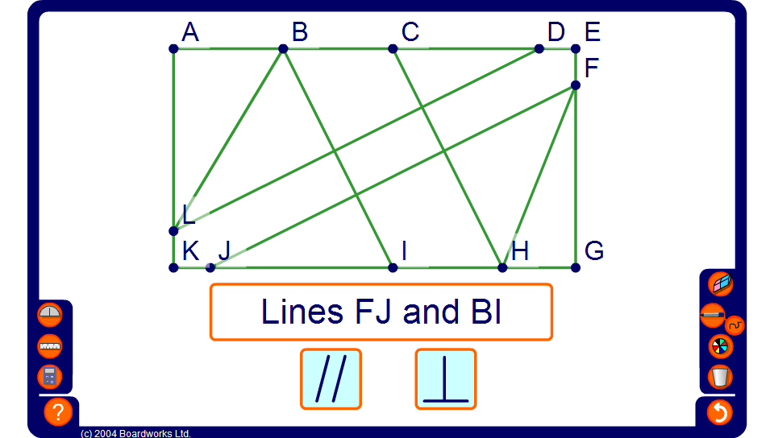


Parallel or perpendicular?
Notes:
Use this activity the identify whether the pairs of lines given are parallel or perpendicular.
This activity will also practice the labeling of lines using their end points.

